Slide 1



DEPARTMENT OF COMPUTER ENGINEERING AND INFORMATICS
UNIVERSITY OF PATRAS
COURSE : DECENTRALIZED SYSTEMS FOR BIG DATA MANAGEMENT
TEACHING PROFESSORS :
SIOUTAS SPYRIDON
VONITSANOS GERASIMOS
APACHE SPARK PROJECT PRESENTATION
PRESENTED BY :
EVANGELOS GERARIDIS
DATE : 30/06/2022

Slide 2

CONTENTS :
INITIALIZING PYSPARK :
GLIMPSE ON THE DATASET
PREPROCESSING
QUERY ONE
QUERY TWO
QUERY THREE
QUERY FOUR
QUERY FIVE
QUERY SIX
QUERY SEVEN

Slide 3
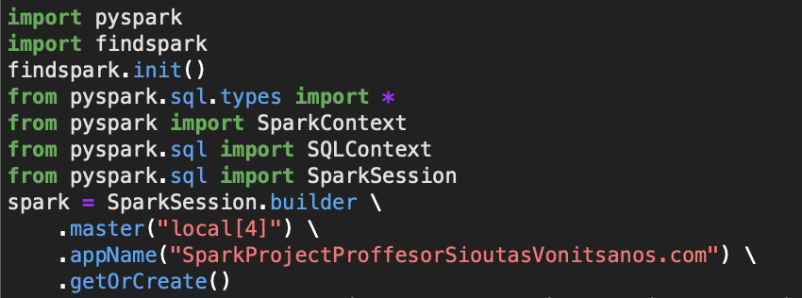
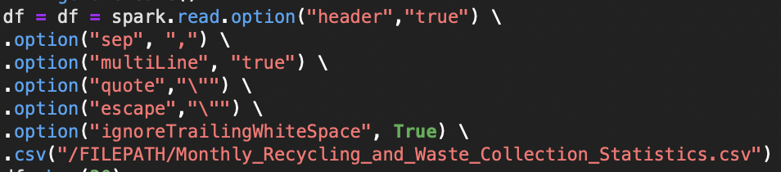
INITIALIZING PYSPARK :
IMPORTING OUR DATASET :

Slide 4


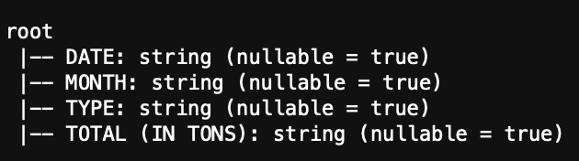
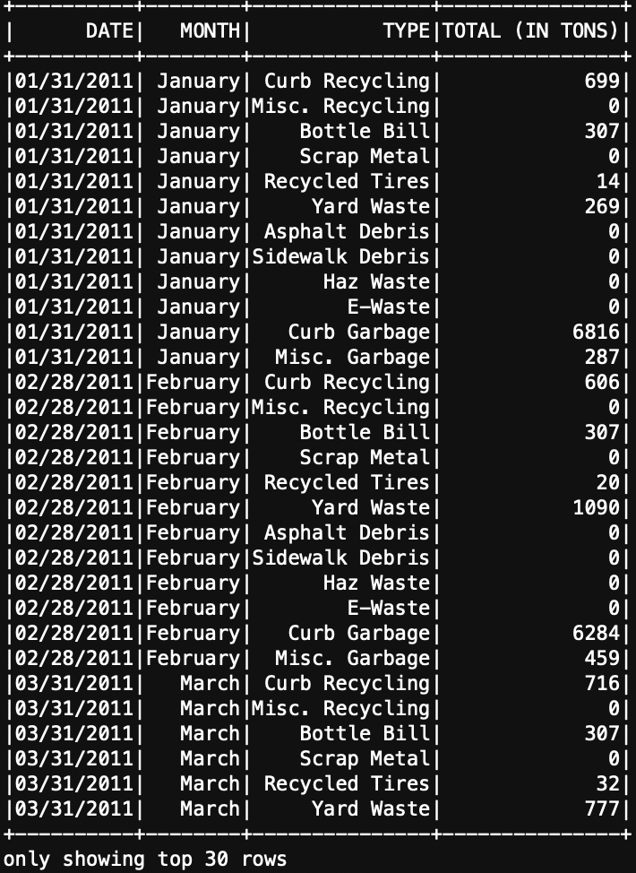
A GLIMPSE ON OUR GIVEN DATASET :
WE HAVE A PROBLEM !
DATE IS A STRING & TOTAL IS A STRING
SOLUTION :
DATE -> DATETYPE
TOTAL -> INTEGER
WHAT ABOUT MISSING DATA ??

Slide 5
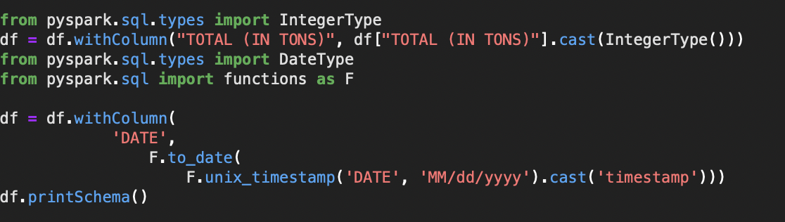
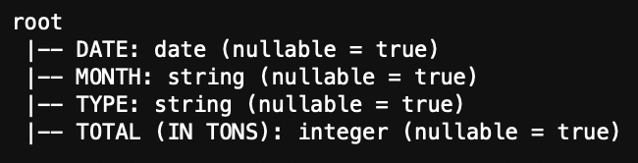

PREPROCESSING :
DATE -> DATETYPE
TOTAL -> INTEGER
MISSING VALUES ?
0 # of nan values ->
No missing values

Slide 6
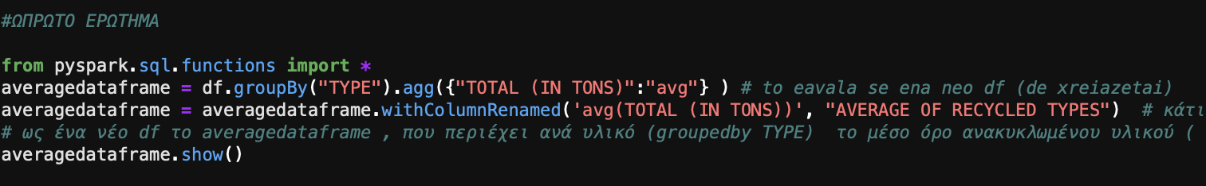
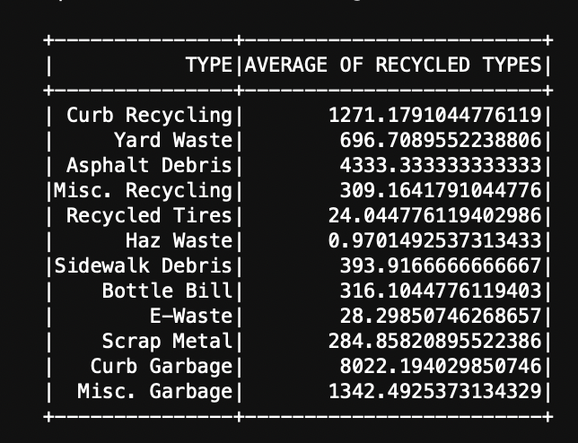
FIRST QUERY :
Average of recycled types in tons :

Slide 7
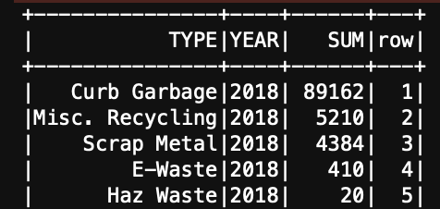
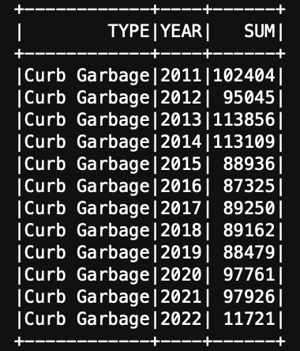
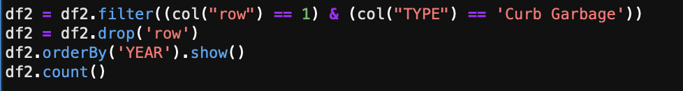
SECOND QUERY :
Choosing the materials :
Ordering the total recycled ammount (per year) of these materials and giving them rank :
Filtering our data to show when our chosen material ( Curb Garbage)
has the highest recycled ammount compared to the other 5 materials.
Curb Garbage has the highest recycled ammount in each one of the 12 years

Slide 8
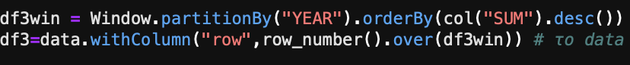
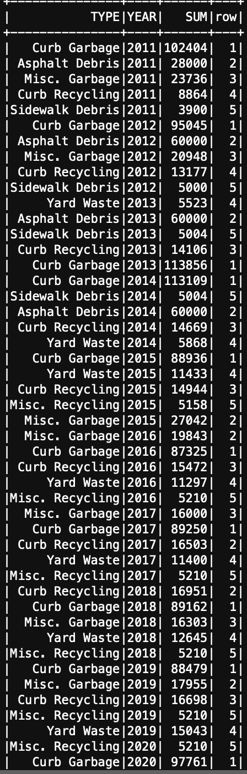
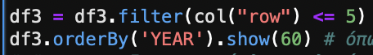
THIRD QUERY :
SIMILAR TO THE SECOND QUERYS LOGIC BUT HERE WE WILL GIVE RANK TO ALL THE MATERIALS OF THE ORIGINAL DATASET
Now we filter our data to show only the first five ranked materials, which means that only the top 5 show regarding their recycled ammount per year.

Slide 9
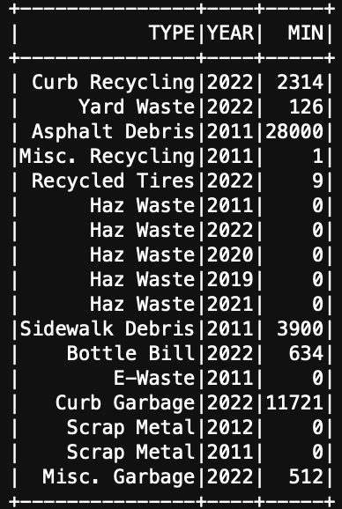
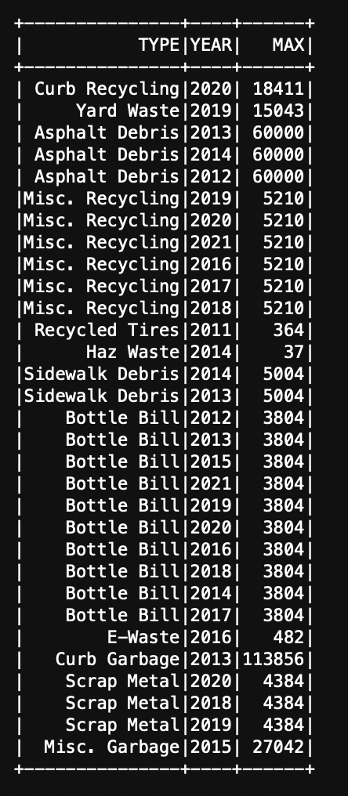
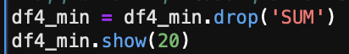
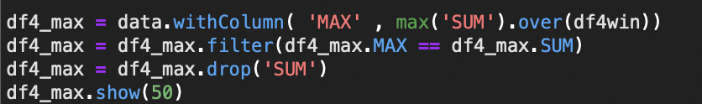
FOURTH QUERY :
WHICH YEAR DOES EACH MATERIAL HAVE EACH MAXIMUM AND MINIMUM RECYCLED AMMOUNTS ?
We create 2 datasets one for the minimum and one for the maximum value for each material

Slide 10
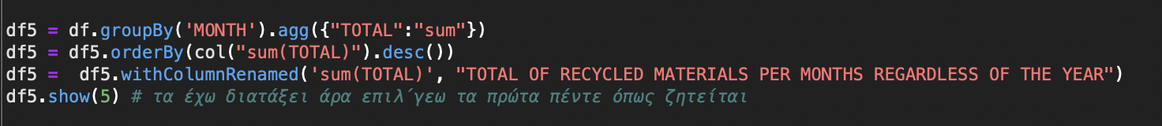
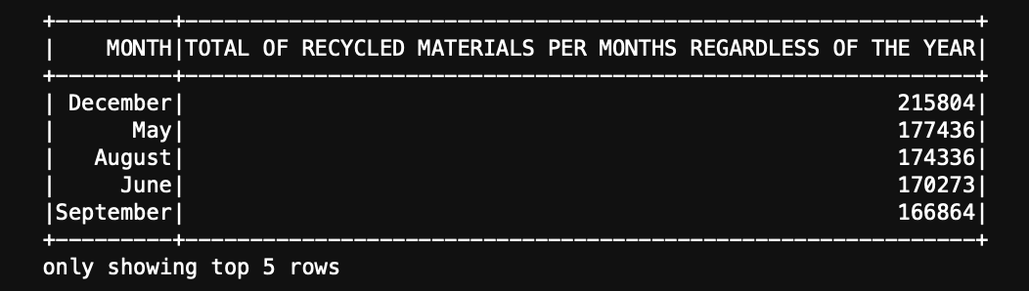
FIFTH QUERY :
TOP 5 MONTHS WITH THE HIGHEST RECYCLED AMMOUNT REGARDLESS OF YEAR AND TYPE.

Slide 11
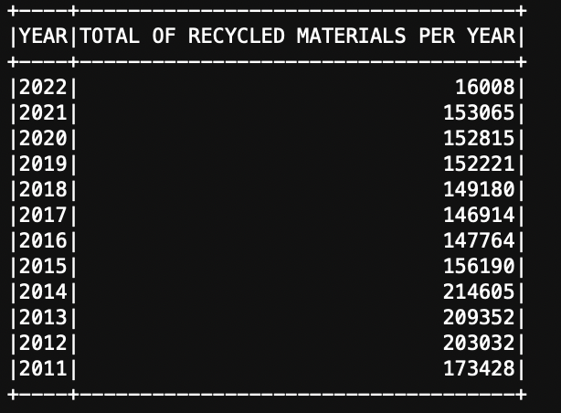
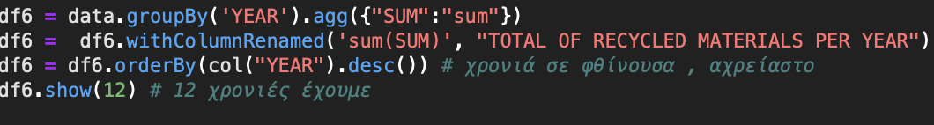
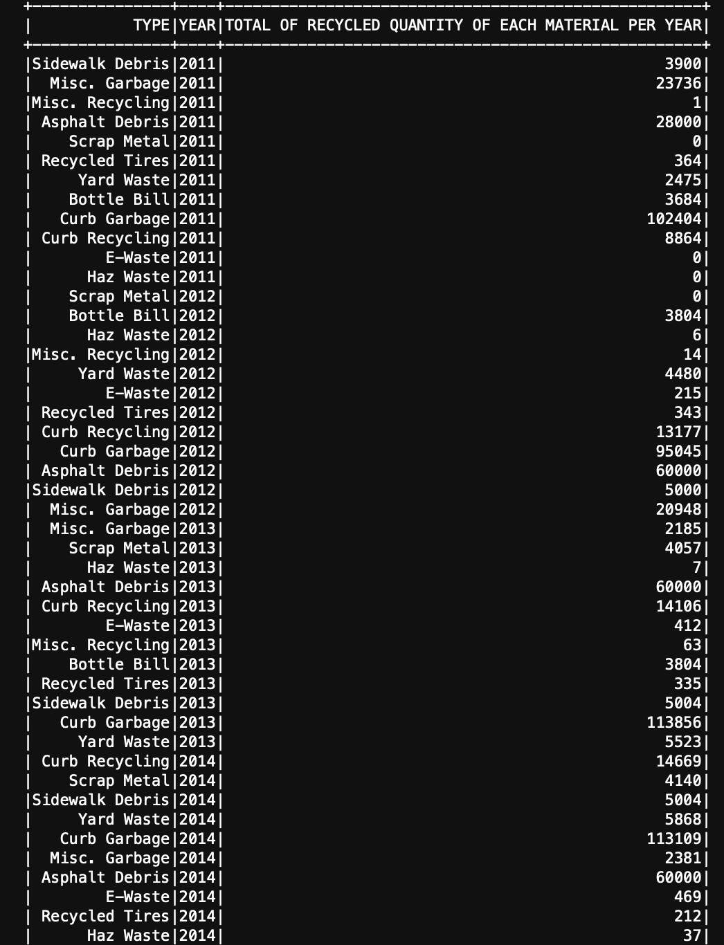
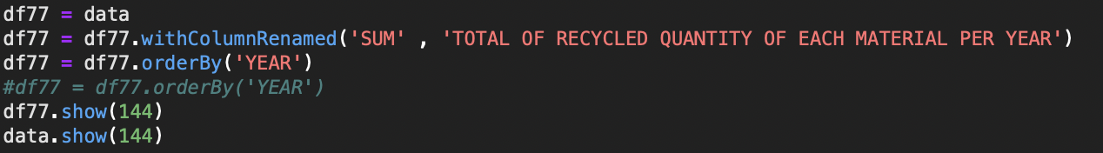
SIXTH QUERY :
TOTAL OF RECYCLED AMMOUNT OF ALL MATERIALS PER YEAR
TOTAL OF RECYCLED QUANTITY OF EACH MATERIAL PER YEAR

Slide 12
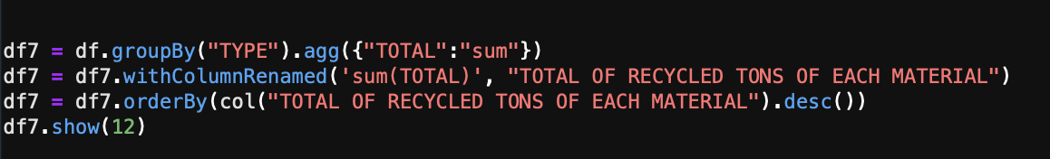
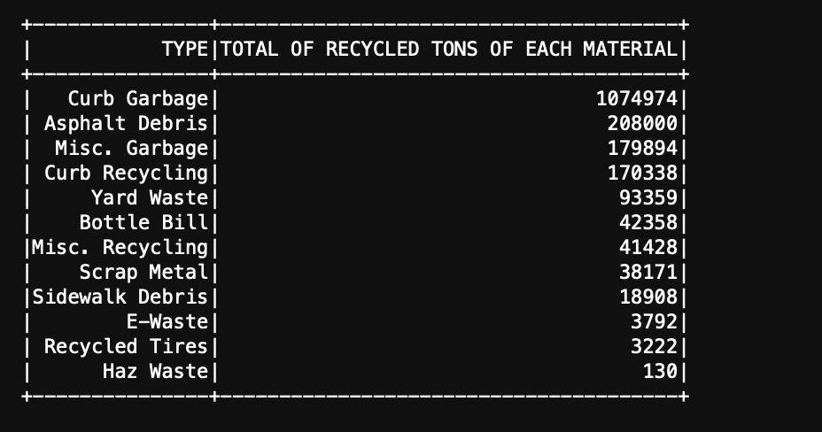
SEVENTH QUERY :
TOTAL OF RECYCLED AMMOUNT OF EACH MATERIALS THROUGH THE 12 YEARS OF COLLECTED DATA. (REGARDLESS OF EACH YEAR)

